Slide 1

VALLURUPALLI NAGESWARA RAO VIGNANA JYOTHI INSTITUTE OF ENGINEERING AND TECHNOLOGY
Department of Computer Science and Engineering
MACHINE LEARNING
Regulation: A19
BTech CSE (III Year-II Sem)
Kriti Ohri
Assistant Professor
Department of Computer Science and Engineering

Slide 2
Simple Linear Regression
The main goal of regression is the construction of an efficient model to predict the dependent attributes from a bunch of attribute variables. A regression problem is when the output variable is either real or a continuous value i.e salary, weight, area, etc.
We can also define regression as a statistical means that is used in applications like housing, investing, etc. It is used to predict the relationship between a dependent variable and a bunch of independent variables. Let us take a look at various types of regression techniques.

Slide 3
Empirical Models
Many problems in engineering and science involve exploring the
relationships between two or more variables
Regression analysis is a statistical technique that is very useful for these types of problems
This model can also be used for process optimization, such as ﬁnding the level of temperature that maximizes yield, or for process control purposes
3

Slide 4
Empirical Models Example
As an illustration, consider the data in the table.
In this table y is the purity of oxygen produced in a chemical distillation process, and x is the percentage of hydrocarbons that are present in the main condenser of the distillation unit.
Hydrocarbon level (X) | Purity (Y)
0.99 | 90.01
1.02 | 89.05
1.15 | 91.43
1.29 | 93.74
1.46 | 96.73
1.36 | 94.45
0.87 | 87.59
1.23 | 91.77
1.55 | 99.42
1.4 | 93.65
4

Slide 5
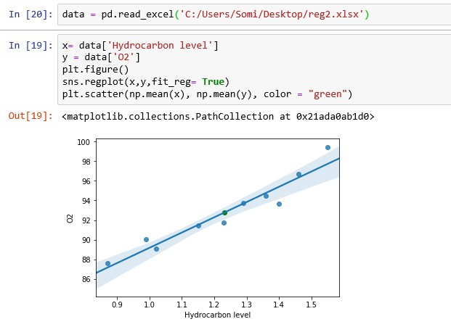
5

Slide 6
Simple Linear Regression Model
The equation that describes how y is related to x and an error term is called the regression model.
The simple linear regression model is:
y = β₀ + β₁x +ε
where:
β₀ and β₁ are called parameters of the model,
ε is a random variable called the error term.

Slide 7
Simple Linear Regression Equation
The simple linear regression equation is:
E(y) = β₀ + β₁x
Graph of the regression equation is a straight line.
β₀ is the y intercept of the regression line.
β1 is the slope of the regression line.
E(y) is the expected value of y for a given x value.
Notes:
Expected value is mean

Slide 8




Simple Linear Regression Equation
Positive Linear Relationship
E(y)
Intercept
b₀
Slope b₁
is positive
x

Slide 9

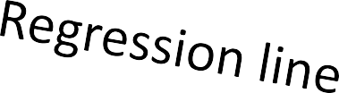


Simple Linear Regression Equation
Negative Linear Relationship
E(y)
Intercept
b₀
Slope b₁
is negative
x

Slide 10


Simple Linear Regression Equation
No Relationship
E(y)
Regression line
Intercept
b₀
Slope b₁is 0
x

Slide 11
Estimated Simple Linear Regression Equation
The estimated simple linear regression equation
𝑦 = 𝑏₀ + 𝑏₁𝑥
The graph is called the estimated regression line.
  b₀ is the y intercept of the line.
  b₁ is the slope of the line.
  y^ is the estimated value of y for a given x value.

Slide 12

∑
Least Squares Method
Least Squares Criterion
ˆ
min
(y − y )
2
i i
where:
y_{i} = observed value of the dependent variable for the ith observation
y_{i} = estimated value of the dependent variable
for the ith observation
^

Slide 13
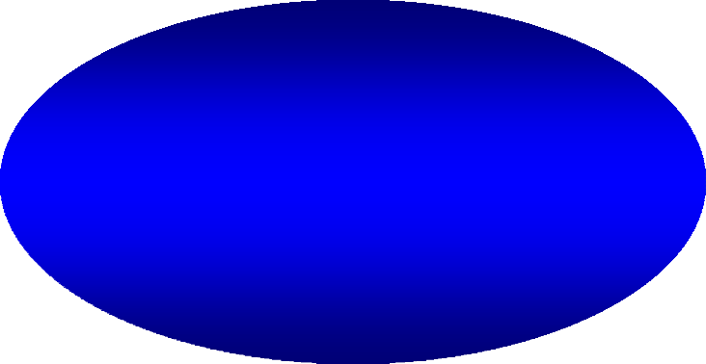

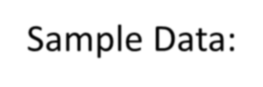
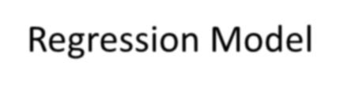


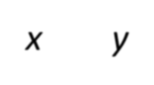
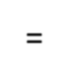
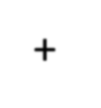





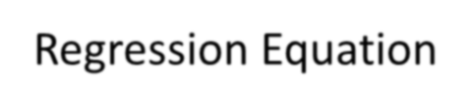





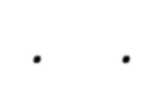

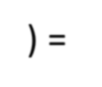

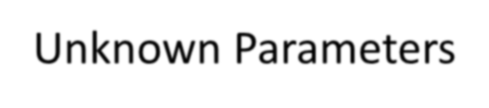







Estimation Process
Regression Model y = β₀ + β₁x +e Regression Equation E(y) = β₀ + β₁x
Unknown Parameters
β₀, β₁
Sample Data:
x y
x₁ y₁
. .
. .
x_{n} y_{n}
Estimated Regression Equation yˆ = b₀ + b₁x Sample Statistics
b₀, b₁
b₀ and b₁
provide estimates of
β₀ and β₁

Slide 14
.... y - (mx +b))²
( ) ( )
2
2
(
Squared Error (SE) = y - (mx +b) + y - (mx +b) +
1 1
2 2
n n
= y ² − 2y (mx +b)+(mx +b)²
1 1 1 1
+y₂ − 2y₂ (mx₂ +b)+(mx₂ +b)
+....
2 2
2
2
+y_{n} − 2y_{n} (mx_{n} +b)+(mx_{n} +b)
= y ² - 2x y m - 2y b+m² x
1 1 1 1
2
1
2mx b+b²
1
+y ² - 2x y m - 2y b+m² x
2 2 2 2
+.....
2
2mx b+b²
2
2
+y ² - 2x
y m - 2y b+m² x
n n n
² +2mx b+b²
n
n
n

Slide 15
=(y ² + y ² + ... + y
2 ₎
1 2 n
−2m (x₁y₁ + x₂ y₂ + ... + x_{n} y_{n} )
−2b(y₁ +y₂ +....+y_{n} )
2 ₎
+m² (x ² +x ² +..+x
1 2 n
+2mb(x₁ +x₂ +..+x_{n} )
+(b² + b² + ... + b² )
= n y ² − 2mn x y − 2bn y+ m²n x ² +2mbnx+nb²

Slide 16
SE=n y ² − 2mn x y − 2bn y+ m²n x ² +2mbnx+nb²
^{∂(SE)} = −2n x y + 2mnx ² + 2bnx = 0
∂m
^{∂(SE)} = −2n xy+ 2mnx
2
2bnx = 0
∂m
2
= − xy+ m x + bx = 0
m x ² + bx = x y
_{x} 2
x y
_{x} 2
x y
one point (
,
)
m +b =
x
x
x
x

Slide 17
SE=n y ² − 2mn x y − 2bn y+ m²n x ² +2mbnx+nb²
^{∂(SE)} = −2n y+ 2mnx + 2nb=0
∂b
=- y+ mx + b = 0
y = mx + b
another point (x, y)

Slide 18
